Slide 1
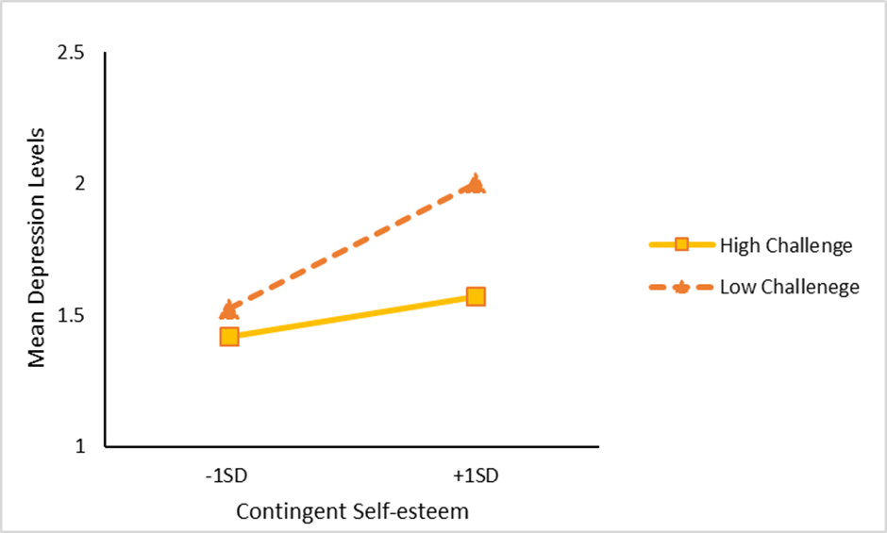
Predicting Depression among Municipal Firefighters: The role of Global Self-Esteem, Contingent Self-Esteem and Challenge Appraisal Osasere Emovon, Joe Tomaka, Ph.D., Public Health Sciences, New Mexico State University
College of Health and Social Services
™
Introduction
Depression is a common health issue affecting millions of people worldwide (Lépine & Briley, 2011). In the United States, about 17.3 million adults or 7.1% of the U.S adult population have experienced at least one major depressive episode in the past year (National Survey on Drug Use and Health, 2017). Although past studies have examined global self-esteem, contingent self-esteem, and challenge appraisal as risk factors for negative emotional states, no studies to date have examined these variables together with regards to mental health outcomes such as depression.
Objectives
To investigate whether global self-esteem, contingent self-esteem, and challenge appraisal would predict depression symptoms independently.
To examine whether these variables interact to predict depression symptoms among municipal firefighters.
Research questions
1) What are the strength and direction of associations among global self-esteem, contingent self-esteem, challenge appraisal, and depression symptoms among municipal firefighters?
2) What are the independent and combined (interactive) effects of global self-esteem, contingent self-esteem, and challenge appraisal on reports of depression among municipal firefighters?
Materials and Methods
This study used a secondary data collected by Morales & Tomaka (2017). Correlation and regression analysis were used to examine the independent and interactive relationships among the variables.
Table 1
Main results of hierarchical regression analyses predicting depressive symptoms
Note: N=737. GSE= Global Self-Esteem; CSE=Contingent Self-Esteem; CH Appraisal= Challenge/Threat Appraisal.
*p < .05. **p<.01. ***p<.001.
Results
The key findings from this study include; global self-esteem associated negatively with depression, contingent self-esteem associated positively with depression, and the tendency to make challenge appraisals associated negatively with depression. Additionally, the results of the regression analyses revealed these effects to be independent of each other, and contingent self-esteem and the tendency to make challenge appraisals interacted to predict depressive symptoms.
Figure 1. Interaction effects of contingent self-esteem and challenge/threat appraisal on symptoms of depression
Discussion
In addition to main effects for all three predictors, this study found contingent self-esteem to interact with the tendency to make challenge appraisals in predicting depressive symptoms. Specifically, the study results suggests that the tendency to make challenge appraisals moderates the relationship between CSE and depression. Those high in CSE who make challenge appraisals report lower depression symptoms compared with those who make low challenge (threat) appraisals. This suggests a stress-buffering effect for the tendency to make challenge appraisals.
This present study is consistent with past research that the tendency to appraise potentially stressful situations as challenging or threatening is associated with several emotional states, patterns of autonomic nervous system activation, and task performance (Blascovich, Mendes, Tomaka, Salomon, & Seery, 2003; Wormwood, Khan, Siegel, Lynn, Dy, Barrett, & Quigley, 2019).
Implications/ Limitations
The findings from this study have implications for future research and mental health promotion. Public health professionals and mental health advocates can explore these variables in creating interventions that may benefit individuals seeking help in achieving better health outcomes. The study limitations include (1) the cross-sectional nature of the study and its inability to prove causality, (2) the unique sample population which was predominantly the male gender.
 | Depression
 | R² Δ | Β
Step 1 | .37***
GSE |  | -.46***
CSE |  | .07*
CH APPRAISAL |  | .21***
Step 2 | .01**
GSE |  | -.44***
CSE |  | .09*
CH APPRAISAL |  | .21***
GSE x CSE |  | .06
GSE x CH APPRAISAL |  | -.03
CSE x CH APPRAISAL |  | .11**
GSE x CSE x CH APPRAISAL |  | -.03
References
Lépine, J. P., & Briley, M. (2011). The increasing burden of
depression. Neuropsychiatric disease and treatment, 7(Suppl 1), 3.
Blascovich, J., Mendes, W. B., Tomaka, J., Salomon, K., & Seery, M. (2003). The robust nature
of the biopsychosocial model challenge and threat: A reply to Wright and Kirby. Personality and Social Psychology Review, 7(3), 234-243.
Kirby. Personality and Social Psychology Review, 7(3), 234-243.
National Survey on Drug Use and Health. (2017). Home page | CBHSQ data. SAMHSA - Substance Abuse and Mental Health Services Administration. https://www.samhsa.gov/data/
Wormwood, J. B., Khan, Z., Siegel, E., Lynn, S. K., Dy, J., Barrett, L. F., & Quigley, K. S.(2019). Physiological indices of challenge and threat: A data‐driven investigation of autonomic nervous system reactivity during an active coping stressor task. Psychophysiology, 56(12), e13454.

