Slide 1
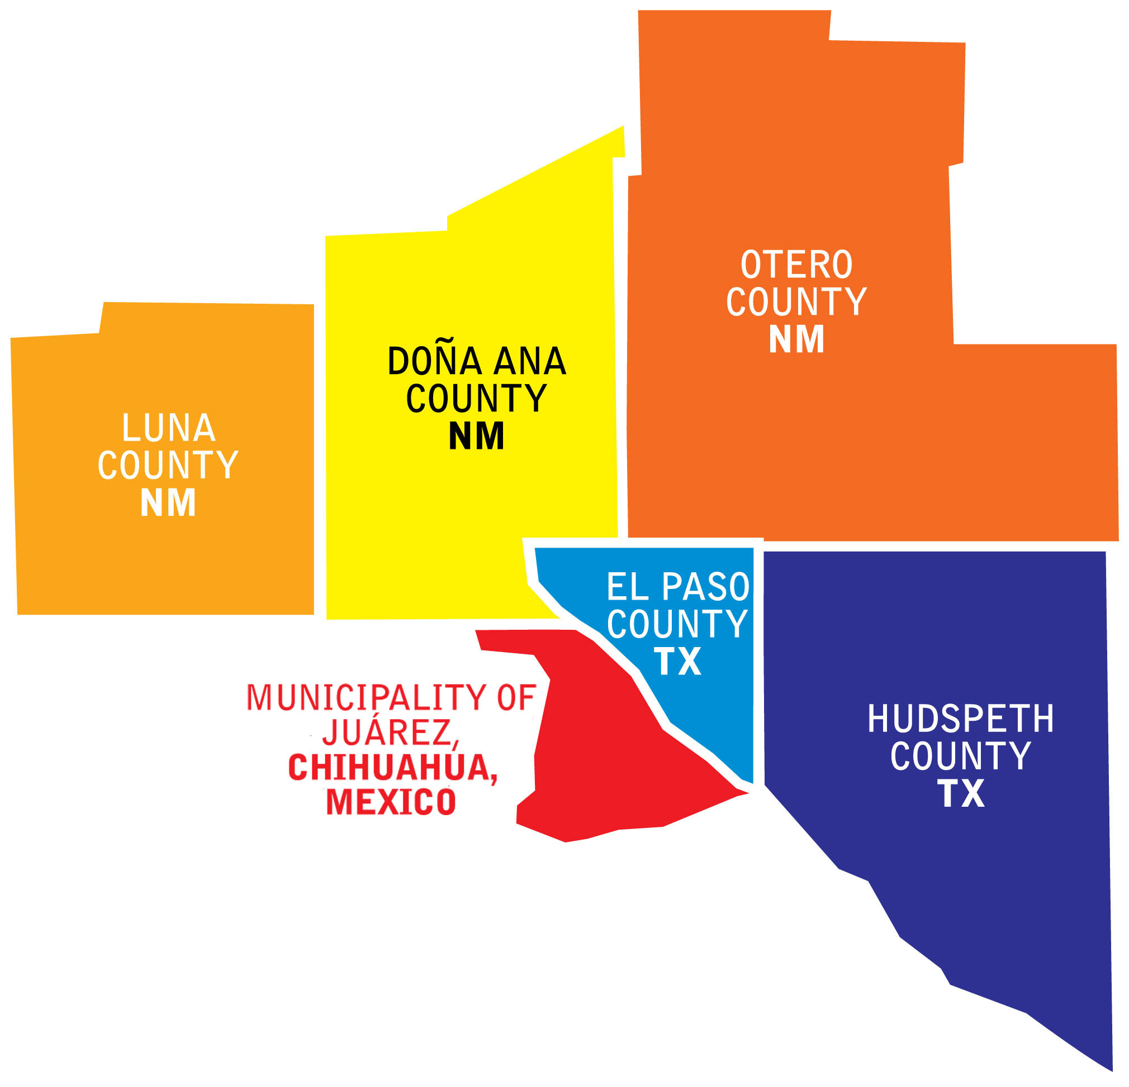
Young Latina survivors in the Paso del Norte Border Region
Map retrieved from [1] Paso del Norte
Health Foundation (2020)
physically and mentally overcoming the challenges of a cancer diagnosis
NMPHA 2020 Annual Conference
October 02, 2020
Clara Reyes, MPH
Program Manager
Taking Time to Connect Randomized Clinical Trial
New Mexico State University (NMSU)

Slide 2
Funding
NCI grants U54 CA132383 (NMSU) and U54 CA132381 (Fred Hutch)
The content is solely the responsibility of the authors and does not necessarily represent the official views of the National Institutes of Health

Slide 3
Objectives
Identify gaps in the literature regarding Latina child-rearing cancer survivors
Describe diagnosed Latina mothers’:
challenges,
facilitators, &
sources of social support
Incorporate findings into interventions for Latina mothers diagnosed with cancer

Slide 4
Background
Gaps in the literature regarding Latina child-rearing cancer survivors

Slide 5
Non-Latina White (NLW) mothers diagnosed with cancer
Compared to older survivors, young NLW breast cancer patients (<45) reported [2]:
lower physical and psychological well-being
greater illness intrusiveness (e.g., employment, family functions)
Compared to survivors without children, survivors with children reported greater [2]:
Illness intrusiveness
(e.g., ability to care for children)
Fears of recurrence
(e.g., potential impact on their family)
Worry and guilt regarding their children’s future should they die

Slide 6
Cancer Survivors in the Border Region
No literature explores the needs of young Latina mothers living with cancer!
much less those living in the U.S.-Mexico border region
Compared to the rest of the U.S., border residents are more likely to [3]:
experience limited access to cancer care
Under- or no insurance
Greater distances to healthcare facilities
Map retrieved from [4] U.S.-Mexico Border Health Commission (2010)

Slide 7
Child-rearing Latina cancer survivors
Increasing cancer incidence trends in young Latinas (<50 years) in the U.S. [5] highlight the need for research exploring how young Latina mothers cope with cancer in the U.S.-Mexico border region
Purpose: describe diagnosed Latina mothers’ (a) challenges, (b) facilitators, and (c) sources of social support in coping with cancer in the Paso del Norte border region.

Slide 8
Methods

Slide 9
Methods
NMSU IRB
Recruitment
Procedure
Qualitative Analysis
Protocol #15032
Latina mother
Diagnosed with cancer
Has a child (5-13 years old)
Lived in Doña Ana or El Paso County
Informed Consent
Demographic/Illness Survey
Focus Group or Interview [Audiotaped]
$25-gift card, a meal, and cancer resource directory
Audiotape transcription
Inductive coding methods adapted from grounded theory [6, 7]
Coding to consensus, formal peer debriefing, and maintaining an audit trail protected the trustworthiness of study results [6]

Slide 10
Results
How did child-rearing Latinas in the Paso del Norte border region describe their cancer-related:
challenges,
facilitators, and
sources of social support?

Slide 11
Participant Characteristics (N=9)
Characteristic | Total (Percentage)
Language
English | 7 (78%)
Spanish | 2 (22%)
Age (yrs.)
<30 | 1 (11%)
30-39 | 4 (44%)
40-49 | 4 (44%)
Age at diagnosis (mean = 35)
<30 | 2 (22%)
30-39 | 6 (67%)
40-49 | 1 (11%)
Characteristic | Total (Percentage)
Education
High school or less | 2 (22%)
Some college, no degree | 2 (22%)
Associate or Bachelor’s degree | 5 (56%)
Marital Status
Married | 6 (67%)
Single or Divorced | 3 (33%)
Employed
Yes | 6 (67%)
No | 3 (33%)
Cancer diagnosis
Breast | 5 (56%)
Thyroid | 2 (22%)
Ovarian | 2 (22%)

Slide 12
Not letting the cancer take any more than it had from me
3 major themes:
Having the Most Difficult Time of My Life
Figuring Out How to Live Day-By-Day
Giving Me the Strength to Fight and Carry On

Slide 13
1. Having the most difficult time of my life
Feeling like treatment is worse then the disease
Being scared to look in the mirror
Feeling very alone
“They always say it can come back, but even harder, stronger.”
“I don’t feel like I was really prepared or educated very well for after effects.”
“My self-image was… crazy…my hair started falling off. It was very emotional, very disturbing.”
“I think they drop you, right, because they see you well.”
“I think just me…really learning how to hold my own hand.”

Slide 14
2. Figuring out how to live day-by-day
Being especially challenging on my home
Needing other things
Getting support & compassion from medical staff
“When I have like procedures I need to get done I sometimes don’t have somebody to take care of them.”
“Not being able to…hold on to the one thing I wanted to, that made me feel normal…was really hard.”
“My nurse was awesome. She… would find anything that I needed to read… even just would call me to check on me at home or talk to me on the phone when I was feeling down.”
“I wish that I had that…a place for me to go and get that support” [Referent: how to communicate with her son about her cancer.]
“Definitely the most difficult challenge was putting that load on my child.” [referent: telling her child she had cancer]
“You do go to the doctor and you do say this is what I’m feeling. And they are like ‘Well, you, it shouldn’t be that bad anymore.’”
“My family tries to help out once in a while but they, they sometimes don’t have money either so. It’s hard.”

Slide 15
3. Giving me the strength to fight and carry on
Having friends and family that were really there for me
Relying on them for normalcy, motivation, and care
“They [her children] never treated me as though I was sick. I was still mom.”
“Support was amazing. I mean, um, I got something so horrible happened, but the most beautiful, just, I feel like I got slapped with love…I have a great support group, um, family and friends.”
“The strength I get from my children…this is my reason to…fight and to carry on.”

Slide 16
3. Giving me the strength to fight and carry on
Talking with other cancer patients was a great support and hopefully I was too
Not letting the cancer stop me
“I would talk to the people around me [during chemo] and that’s what helped me realize, ‘Oh, there is such a thing as chemo brain.’”
“If you let your diagnosis…get to your head, you’re going to lose the battle…You have to be mentally stronger.”
“They [other survivors] don’t drop you because they know…what you are feeling”
“I wasn’t going to let cancer take any more than it had from me. That was my attitude from the beginning.”

Slide 17
Discussion & Implications
How can we incorporate findings into interventions for Latina mothers diagnosed with cancer?

Slide 18
Discussion & Implications
Interventions for Latina Survivors should:
Latina Cultural Values
build on their fighting spirit [8]
incorporate relational coping and familism [8-10]
evaluate Latina survivors’ perceived isolation and support needs throughout survivorship [10]
connect them with survivors for personalized and continued support
physicians, patients, and patients’ families should receive education on the therapeutic value of connecting survivors (e.g., support groups; cancer buddies) [11]
Fear and Isolation

Slide 19
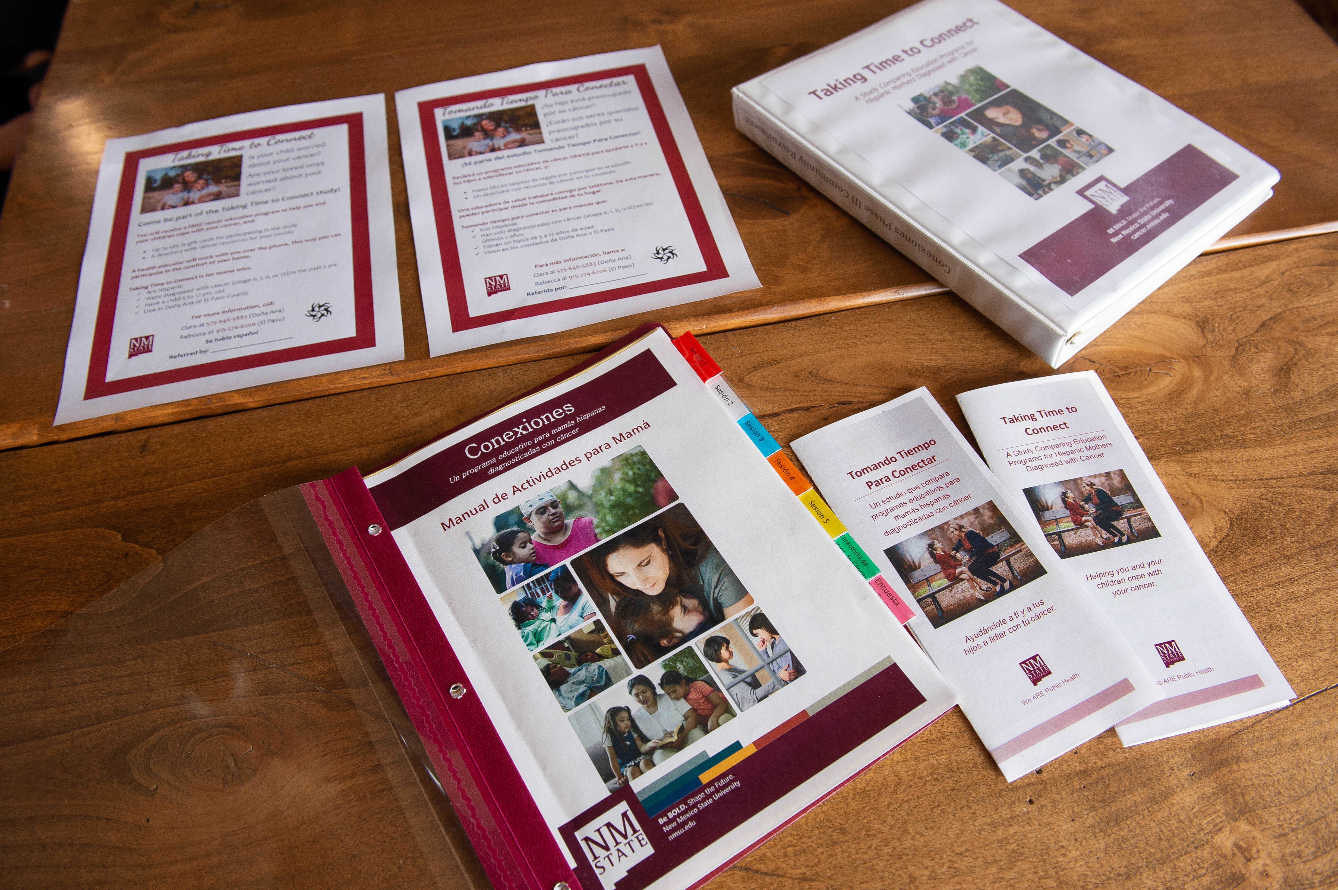
Adapted Intervention for Latina Cancer Survivors
Cultural adaptation of cancer parenting education program for Latina mothers diagnosed with cancer (Co-PIs Lewis & Palacios) [12]
Enhancing Connections → Conexiones
A Latina Community’s Evaluation of the culturally-adapted Conexiones Program
Isela Garcia: Poster#3 today at 2:30pm
Feasibility Study
Adriena Hernandez: Session 3B
Randomized Clinical Trial (RCT)

Slide 20
Taking Time to Connect
An RCT for Latina mothers diagnosed with cancer
Compares 2 cancer education programs:
Which is more effective in helping Latina mothers and their children cope with cancer?
Conducted entirely by phone in English or Spanish
Designed for mothers who:
Are Latina
Have been diagnosed with cancer (stages 0, I, II, o III) in the last 2 years
Have a child 5-17 years old
Live in one of the following counties:
Doña Ana, Luna, Otero, Hidalgo, or Bernalillo, New Mexico, or
El Paso, Texas

Slide 21
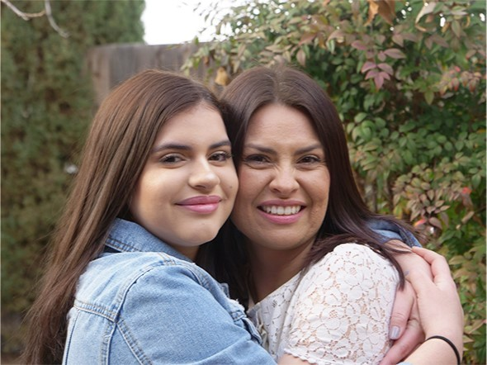
Help families thrive, not merely survive, cancer
Expand on limited research in Latina mothers diagnosed with cancer
And Latino cancer survivors in general

Slide 22
Acknowledgments
Women that participate in our research
NMSU-UW TTTC Team
Memorial Cancer Center, MMC, Las Cruces
Office of Community Health Workers, NMDOH, Las Cruces
Community Health Workers
Dona Ana County
And many others…

Slide 23
References
Paso del Norte Health Foundation. Overview: Region. 2020. Retrieved from: https://pdnhf.org/who_we_are
Ares, I., S. Lebel, and C. Bielajew, The impact of motherhood on perceived stress, illness intrusiveness and fear of cancer recurrence in young breast cancer survivors over time. Psychol Health, 2014. 29(6): p. 651-70.
Herrera, D.G., et al., Cervical cancer screening in the US-Mexico border region: a binational analysis. Matern Child Health J, 2012. 16 Suppl 2: p. 298-306.
U.S.-Mexico Border Health Commission. Border Lives: Health Status in the United States-Mexico Border Region. 2010. Retrieved from: https://www.ruralhealthinfo.org/assets/940-3105/health-status-in-the-united-states-mexico-border-region.pdf.
State Cancer Profiles, Incidence Rate Report by State for All Cancer Sites (All Stages) (2012-2016) in Hispanic (any race) Females Ages<50. 2019.
Thomas, D.R., A general inductive approach for analyzing qualitative evaluation data. American Journal of Evaluation, 2006. 27(2): p. 237-246.
Lewis, F.M. and L.W. Deal, Balancing our lives: a study of the married couple's experience with breast cancer recurrence. Oncol Nurs Forum, 1995. 22(6): p. 943-53.
Gonzalez, P., et al., Coping with breast cancer: Reflections from Chinese American, Korean American, and Mexican American women. Health Psychol, 2016. 35(1): p. 19-28.
Yoo, G.J., E.G. Levine, and R. Pasick, Breast cancer and coping among women of color: a systematic review of the literature. Support Care Cancer, 2014. 22(3): p. 811-24.
Nápoles-Springer, A.M., et al., Use of cancer support groups among Latina breast cancer survivors. J Cancer Surviv, 2007. 1(3): p. 193-204.
Martinez Tyson, D., P. Jacobsen, and C.D. Meade, Understanding the Stress Management Needs and Preferences of Latinas Undergoing Chemotherapy. Journal of Cancer Education, 2016. 31(4): p. 633-639.
Reyes, C., Freeman, L, Sondgeroth, K., Palacios, R. Culturally Tailoring the Enhancing Connections (EC) Program for Hispanic Mothers Diagnosed with Cancer in the Border Region. Southwest Institute for Health Disparities Research: 2016 Conference Cross-Border Opportunities for Health Promotion over the Life Span, September 30, 2016.

Slide 24
Thank you!
Clara Reyes, MPH
(575) 646-5883
clreyes@nmsu.edu
https://cancer.nmsu.edu/ttcpilot.html
Dr. Rebecca Palacios, PI
(575) 646-4309
rpalacio@nmsu.edu
https://cancer.nmsu.edu/ttcpilot.html

